Slide 1
MIS 7720 #6 Supervised Learning

Slide 2
Supervised learning
Building models from labeled data
split data Train/Test
Models (depending on outcome data type)
Numeric prediction (Regression) – continuous outcome
Classification - Categorical outcome
Time series
What if my data is text, image, … ?
Will talk about those later (NN, Deep Learning, NLP )

Slide 3
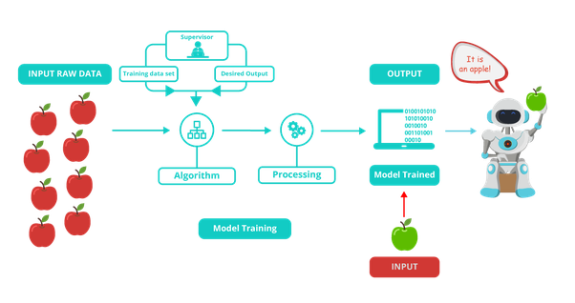
Overview

Slide 4
Steps – supervised learning
Gathering data
Preparing that data (pre-processing)
Choosing models
Model training
Model evaluation
Hyperparameter tuning
Prediction (for new inputs)

Slide 5
Quick Python note
Classes
The model of something we want to build
Objects
An instance of the class
Method
A tool we can use on the object to complete a specific action

Slide 6
Data pre-processing
Missing data
Deletion
Imputation
Encoding (for categorical variables)
Multiple Levels
Dummy (binary) variables, one for each level
Feature scaling
Feature engineering: process of using domain knowledge of the data to create features that make ML algorithms work. Difficult, time-consuming, expensive!

Slide 7
Missing data – possible reasons
Missing completely at random (MCAR) – rarely the case
The reasons for missing data are independent both of observable and of unobservable parameters of interest and occur entirely at random.
Missing at random (MAR)
The probability of missing is independent of values of the outcome variable, after conditioning on other observed variables.
Missing not at random (MNAR) – worst case
The missing data depends both on observed variables and the outcome variable.
There are approaches to account
Notes:
https://en.wikipedia.org/wiki/Missing_data
https://github.com/PyDataSanLuis/conference/blob/master/Posters/PyDataSL_Missing_Data_Poster.pdf

Slide 8
Missing data – what to do
Handling missing data
Deletion
Deleting rows
Pairwise deletion
Imputation
Time-series
Deleting columns
General problem
Categorical
Continuous
Make NA as level, multiple imputation, logistic regression
Mean, median, mode, multiple imputation, linear regression
Without trend & wo seasonality
With trend & wo seasonality
With trend & with seasonality
Mean, Median, Mode, Random sample imputation
Linear interpolation
Seasonal adjustment + interpolation
Notes:
Hands-on Python, R

Slide 9
Imputation – Missing Data
Replace the missing data with substitute values
Mean, Median, Mode of available cases (of the same variable)
Regression
Predicted value of the datapoint based on other variables using from a regression model; regress X_{missing} on X_{observed}
Multiple imputation (more advanced)
See slide notes
R: “mice” library
Python: “fancyimpute” library
Notes:
https://www.mailman.columbia.edu/research/population-health-methods/missing-data-and-multiple-imputation
https://www.r-bloggers.com/imputing-missing-data-with-r-mice-package/
https://pypi.org/project/fancyimpute/

Slide 10
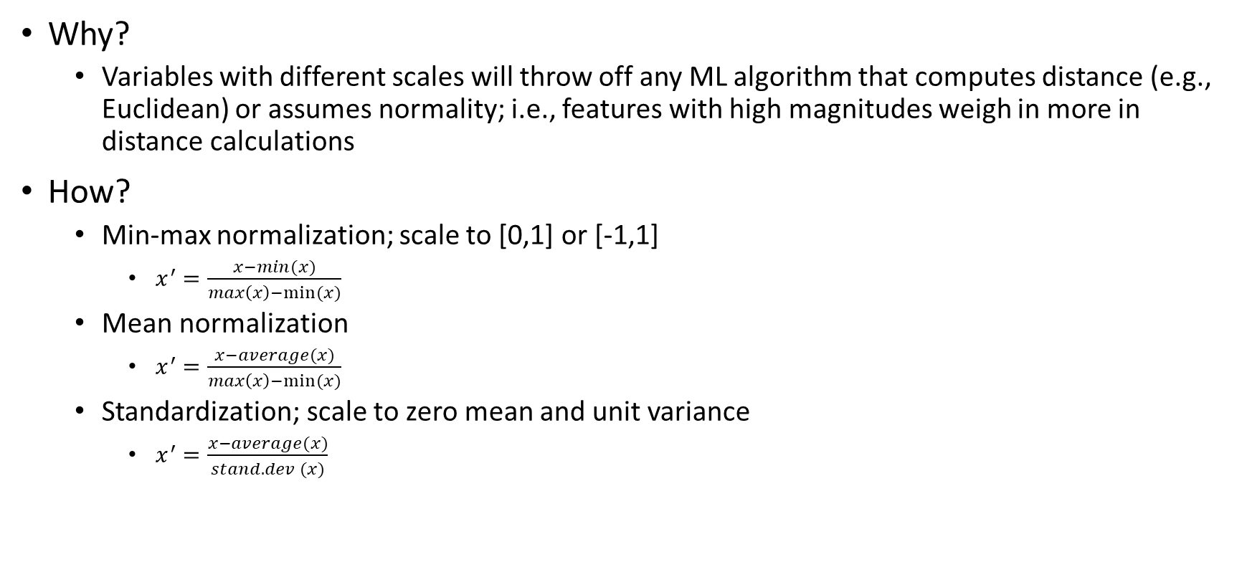
Feature scaling
Why?
Variables with different scales will throw off any ML algorithm that computes distance (e.g., Euclidean) or assumes normality; i.e., features with high magnitudes weigh in more in distance calculations
How?
Min-max normalization; scale to [0,1] or [-1,1]
$x^{′}=\frac{x−min(x)}{max\left(x\right)−min⁡(x)}$
Mean normalization
$x^{′}=\frac{x−average(x)}{max\left(x\right)−min⁡(x)}$
Standardization; scale to zero mean and unit variance
$x^{′}=\frac{x−average(x)}{stand. dev (x)}$
Notes:
Automated feature engineering in python: featuretools (https://www.featuretools.com/)
R libraries:
“caret” (ClAssifiation and REgression Tools) in R has feature selection methods
“textfeatures” extracting generic features from text (will discuss in NLP)

Slide 11
Sample datasets
Numeric prediction (regression models)
Data on 50 startups
R&D Spend, Administration, Marketing Spend, State, Profit
Classification
Data on social network Ads
UserID, Gender, Age, Estimated salary, Purchased
Notes:
Hands-on R, python

Slide 12
Training and Testing
Splitting the data
Training Dataset: The sample of data used to fit the model.
Validation Dataset: The sample of data used to provide an unbiased evaluation of a model fit on the training dataset while tuning model hyperparameters.
Test Dataset: The sample of data used to provide an unbiased evaluation of a final model fit on the training dataset.
Other methods where Test datasets disappear
K-fold cross validation (will discuss later)
Notes:
https://machinelearningmastery.com/difference-test-validation-datasets/

Slide 13
Numeric Prediction models
Supervised Learning

Slide 14
Examples
Predicting future car prices given car information
Predicting (monthly) firm profits
Predicting job satisfaction score of employees
Predicting student GPA
Predicting revenue for cloud services
Predict demand for products
…

Slide 15
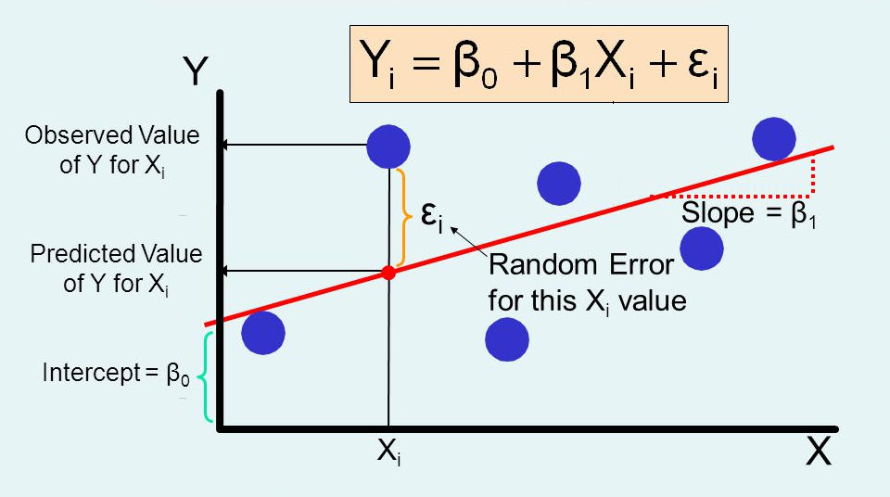

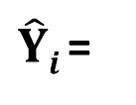
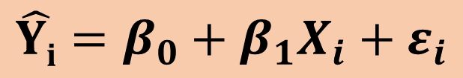
Linear regression
$$\hat{Yi}=β_{0}+β_{1}X_{i}+ε_{i}$$
Find a line that…
Minimizes
$$Sum {\left(Yi−\hat{Y}i\right)}^{2}$$
Y_{i} =
$\hat{Y}i$ =
Notes:
Hands-on R, python

Slide 16
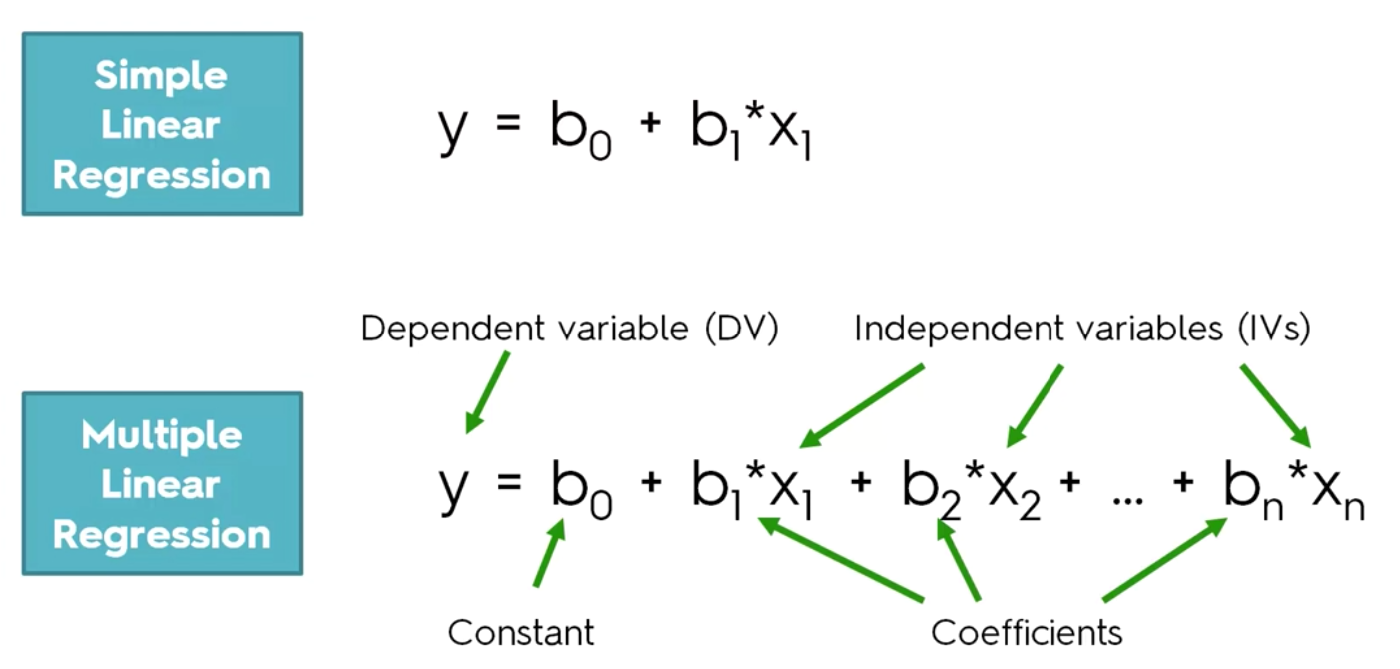
Multiple linear regression
Multiple predictors
Notes:
Hands-on R, python

Slide 17
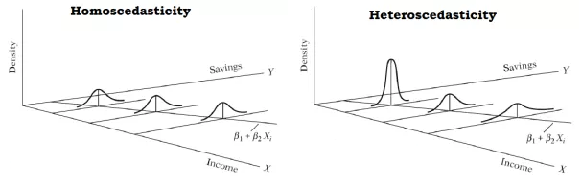
Linear regression assumptions
Linearity: linear relationship between Y and Xs
Lack of multicollinearity
Independent/predictor variables (Xs) should not be highly correlated
Identify and remove variables causing it; try centering X variables (substract mean)
Homoscedasticity: homogeneity of variance
Error terms have similar variance
Error terms should be normally distributed
Independence of error terms
If assumptions fail model is not necessarily wrong but biased and/or inefficient
Notes:
Biased: the estimated value for a coefficient/estimator is different from its actual value (assuming we knew it)
Inefficient: the estimated variance is unnecessarily large (compared to a theoretically minimum variance unbiased estimator)

Slide 18
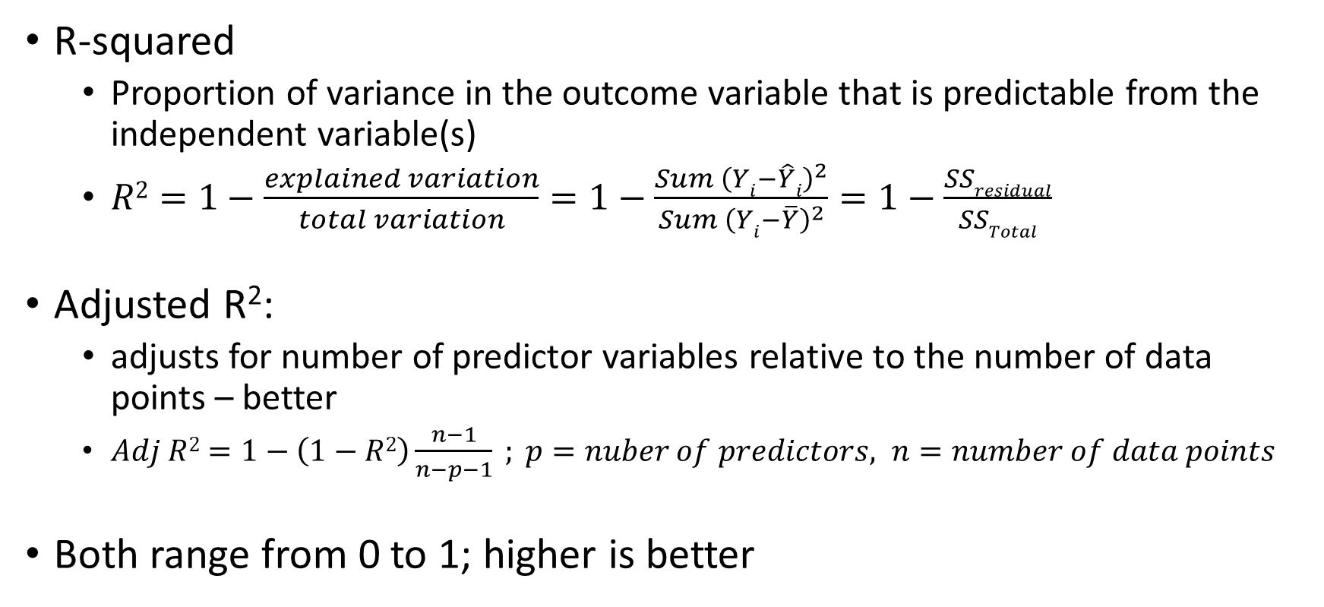
Model evaluation – R² , Adjusted R²
R-squared
Proportion of variance in the outcome variable that is predictable from the independent variable(s)
$R2=1−\frac{explained variation}{total variation}=1−\frac{Sum {\left(Yi−\hat{Y}i\right)}^{2}}{Sum {\left(Yi−\overline{Y}\right)}^{2}}=1−\frac{SSresidual}{SSTotal}$
Adjusted R²:
adjusts for number of predictor variables relative to the number of data points – better
$Adj R2=1−\left(1−R2\right)\frac{n−1}{n−p−1} ; p=nuber of predictors, n=number of data points$
Both range from 0 to 1; higher is better
Notes:
https://machinelearningmastery.com/metrics-evaluate-machine-learning-algorithms-python/
Note: AIC, BIC are not used as performance metrics since they are model selection (not evaluation) metrics. Cross Validation is a better approach for model selection.
https://amstat.tandfonline.com/doi/abs/10.1080/00031305.1985.10479448#.XFfoMVxKiiM

Slide 19


Model evaluation – RMSE, MAE
Root mean squared error (RMSE)
Mean squared error (MSE)
Mean Absolute Error (MAE)
Range from 0 to ∞ ; lower is better
Express average model prediction error in same units as the outcome variable
Good measure of how accurately the model predicts the response
Notes:
For Hands-on practice R, python, see:
https://medium.com/human-in-a-machine-world/mae-and-rmse-which-metric-is-better-e60ac3bde13d
Sklearn: https://scikit-learn.org/stable/modules/model_evaluation.html#regression-metrics

Slide 20
Decision Tree Regression
Regression Trees
Splits data (into leaves) based on predictor variables
Decision of where to split is based on
SSE – linear relationship between Y and X(s)
Information entropy – nonlinear relationship between Y and X(s)
Continues splitting until …
Number of data points in terminal leaves fall below threshold
or; there is no significant reduction in SSE
or; there is no information gain (entropy)
Notes:
* Details are skipped…

Slide 21
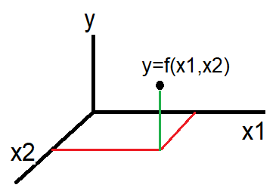
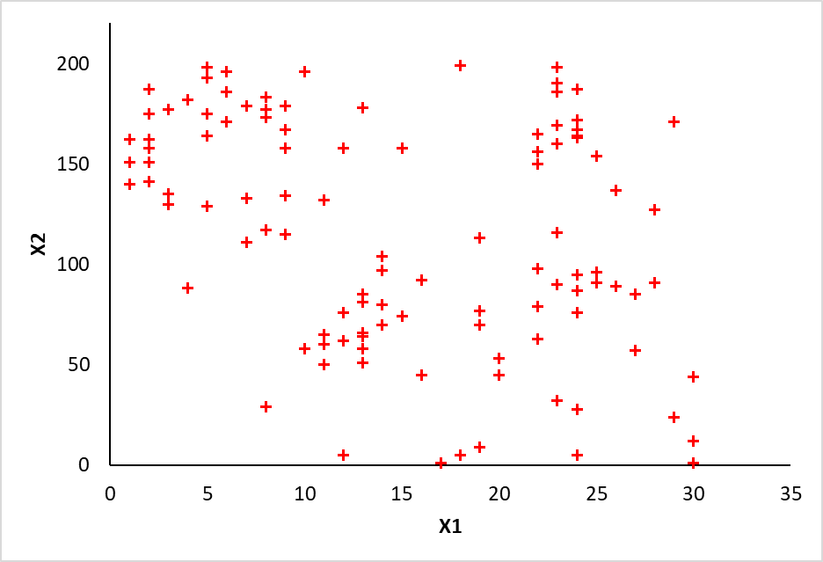
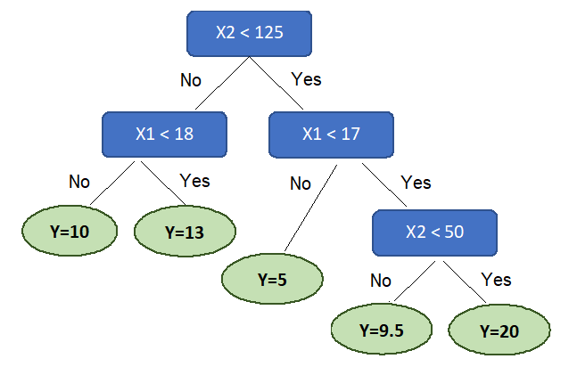
Regression tree intuition
Y=10
Split 2
Y=13
Split 1
Y=9.5
Split 3
Y=5
Split 4
Y=20
Notes:
Metric to determine best split? A metric that measures the homogeneity of the target variable within subsets.
Variance Reduction
Information Gain (decrease in Entropy): for details, see https://towardsdatascience.com/entropy-and-information-gain-b738ca8abd2a
High entropy = more uncertainty/randomness
Low entropy = more predictability/ less randomness

Slide 22
Random Forest Regression – intuition
An ensemble learning method
Uses multiple algorithms (or an algorithm multiple times) to obtain better predictive performance
How does it work?
Pick random K data points from the training set
Build the decision tree for these K data points
Choose the number of trees (N) to build and repeat steps 1 & 2
For a new data point, make each of these N trees predict the value of Y and assign the average across all of the predicted Y values.
Notes:
https://blog.statsbot.co/ensemble-learning-d1dcd548e936

Slide 23
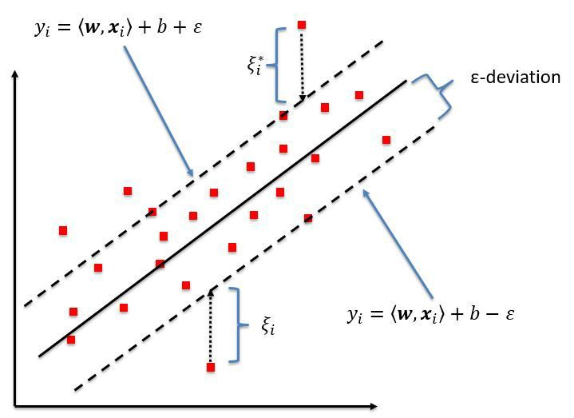
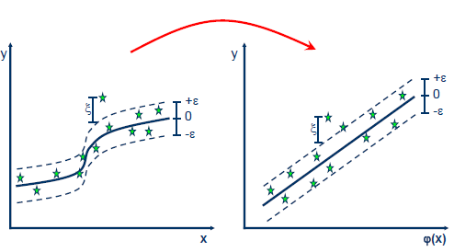
Support Vector Regression (SVR)
SVR performs linear (non-linear) regression in a higher dimensional space
Width of error band is controlled by hyperparameter ε
The regression goal in SVR is to make sure the errors do not exceed the threshold; i.e., it classifies all linear predictions into those that pass the error band and those that do not.
Notes:
Instead of trying to fit the largest possible street/margin between the two classes while limiting margin violations (what we have in SVM), SVR tries to fit as many instances as possible on the street while limiting margin violations
See SVM (slides 40-42) first!!
Hands-on in python
Type of SVM that supports linear and non-linear regression.

Slide 24
Numeric prediction – model comparison
Model | Pros | Cons
Linear regression | Works on any size of dataset, gives information about relevance of features | The Linear Regression Assumptions
Polynomial regression | Works on any size of dataset, works very well on non-linear problems | Need to choose the right polynomial degree for a good bias/variance tradeoff
Support Vector regression | Easily adaptable, works very well on non-linear problems, not biased by outliers | Need to apply feature scaling, more difficult to understand (explain)
Decision Tree regression | Interpretability, no need for feature scaling, works on both linear/non-linear problems | Poor results on small datasets, overfitting can easily occur
Random Forest regression | Powerful and accurate, good performance on many problems including non-linear | No interpretability, overfitting can easily occur, need to choose number of trees

Slide 25
Classification
Supervised Learning

Slide 26
Classification examples
Two class classification (binary outcome)
Multiclass classification
Examples
Spam filter
Predict app adoption
Predict customer risk level (e.g., low, medium, high)
Credit default risk
Power line fault detection
Object recognition (classification plus more)
Image type detection

Slide 27
Example – Employee Retention Analysis
Notes:
EmployeeRetentionData.csv

Slide 28



Model evaluation – Precision, Recall, Accuracy
Confusion matrix
 | Predicted
Actual |  | Spam | Not Spam
 | Spam | A = 10 | B = 2
 | Not Spam | C = 8 | D = 80
 | Predicted
Actual |  | Spam | Not Spam
 | Not Spam | C | D
 | Spam | A | B
$$Precision=\frac{A}{A+C}=\frac{10}{18}$$
$$Recall=\frac{A}{A+B}=\frac{10}{12}$$
 | Actual
Predicted |  | Spam | Not Spam
 | Spam | A | C
 | Not Spam | B | D
$$Accuracy=\frac{A+D}{A+B+C+D}=\frac{90}{100}$$
Notes:
https://scikit-learn.org/stable/modules/model_evaluation.html#classification-metrics

Slide 29

Model evaluation – TPR, FPR, …
 | Predicted
Actual |  | Positive | Negative
 | Positive | TP | FN
 | Negative | FP | TN
$$True Positive Rate\left(TPR\right)=\frac{TP}{TP+FN}=Recall=Sensitivity$$
$$False Positive Rate\left(FPR\right)=\frac{FP}{FP+TN}=1−Specificity$$
$$True Negative Rate\left(TNR\right)=\frac{TN}{TN+FP}=Specificity$$
$$False Negative Rate\left(FNR\right)=\frac{FN}{FN+TP}$$
Notes:
https://scikit-learn.org/stable/modules/model_evaluation.html#classification-metrics

Slide 30



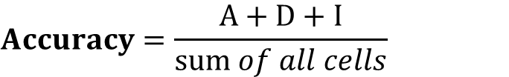

Model evaluation – Multiple outcomes
Confusion matrix
 | Predicted
Actual |  | Low | Medium | High
 | Low | A | B | E
 | Medium | C | D | F
 | High | G | H | I
$$PrecisionLow=\frac{A}{A+C+G}$$
$$PrecisionMedium=\frac{B}{B+D+H}$$
$$RecallLow=\frac{A}{A+B+E}$$
$$RecallMedium=\frac{B}{A+B+E}$$
$$Accuracy=\frac{A+D+I}{sum of all cells}$$
Notes:
Multiclass classification

Slide 31
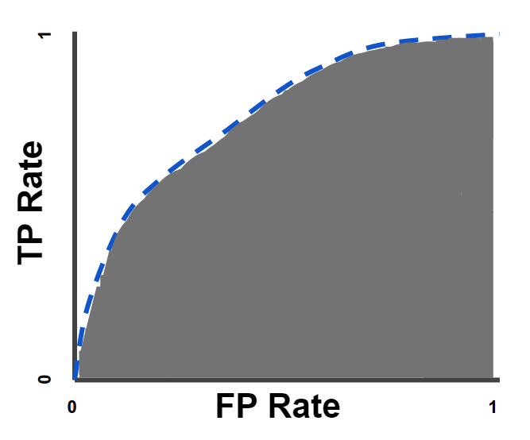
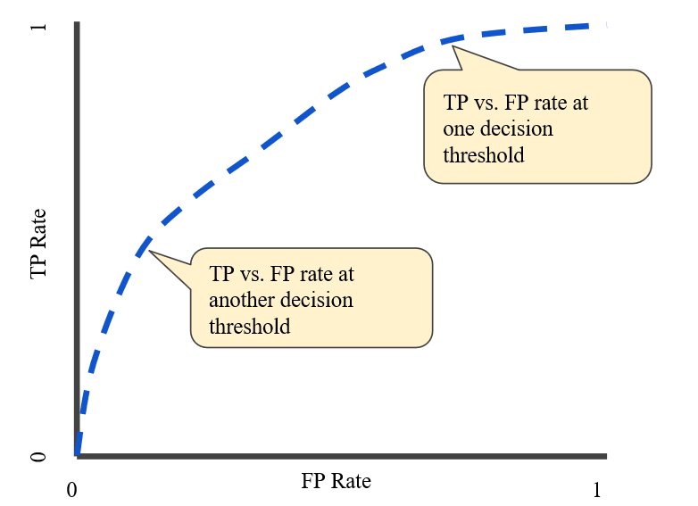
Model evaluation – ROC, AUC
ROC – Receiver Operating characteristic Curve: shows the performance of a classifier at all classification thresholds
AUC – Area Under the ROC Curve: aggregate measure of performance
Random Guess?
Perfect Model?
Good for Balanced Outcomes
Notes:
AUC is desirable for the following two reasons:
AUC is scale-invariant. It measures how well predictions are ranked, rather than their absolute values.
AUC is classification-threshold-invariant. It measures the quality of the model's predictions irrespective of what classification threshold is chosen.
However, both these reasons come with caveats, which may limit the usefulness of AUC in certain use cases:
Scale invariance is not always desirable. For example, sometimes we really do need well calibrated probability outputs, and AUC won’t tell us about that.
Classification-threshold invariance is not always desirable. In cases where there are wide disparities in the cost of false negatives vs. false positives, it may be critical to minimize one type of classification error. For example, when doing email spam detection, you likely want to prioritize minimizing false positives (even if that results in a significant increase of false negatives). AUC isn't a useful metric for this type of optimization.
https://scikit-learn.org/stable/modules/generated/sklearn.metrics.roc_curve.html#sklearn.metrics.roc_curve

Slide 32
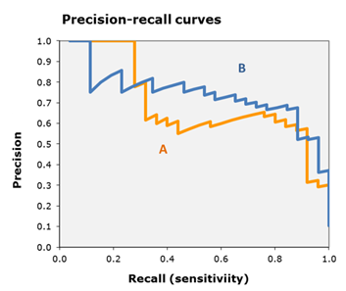
Model evaluation – Precision-Recall curves
Plot it for each outcome class
Example shows the curves for A and B outcomes
Shows the trade-off in Precision as we gain higher Recall
Random Guess?
Perfect Model?
Good for Imbalanced Outcomes
Notes:
A good diagnostic tool for (very) imbalanced outcome classes.
Show line for Random Guessing
Show line for a (hypothetical) perfect model
https://scikit-learn.org/stable/auto_examples/model_selection/plot_precision_recall.html

Slide 33
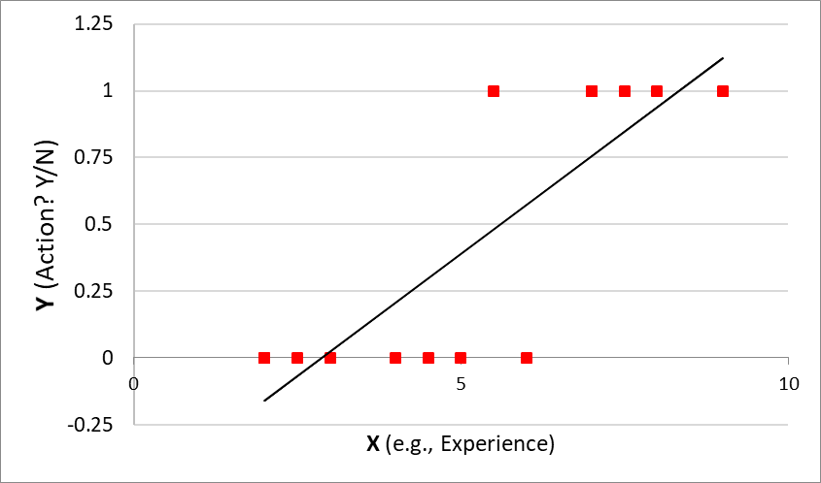
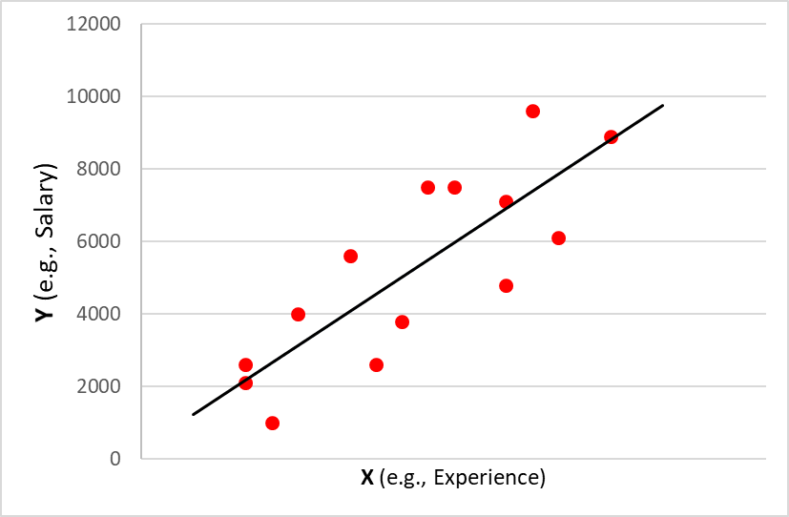
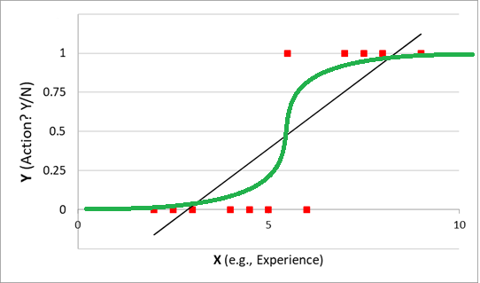
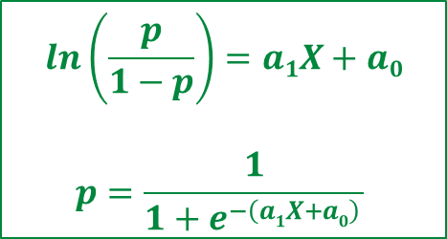
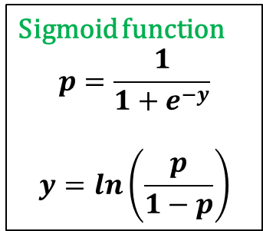


Logistic Regression
$Y=a1X+a0$
$y=a1X+a0$
Sigmoid function
$$p=\frac{1}{1+e^{−y}}$$
$$y=ln\left(\frac{p}{1−p}\right)$$
$$ln\left(\frac{p}{1−p}\right)=a1X+a0$$
$$p=\frac{1}{1+e^{−\left(a1X+a0\right) }}$$

Slide 34



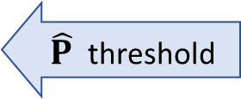
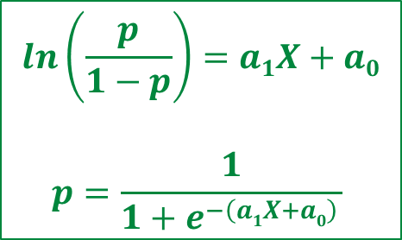
Logistic Regression
Sigmoid function
$$p=\frac{1}{1+e^{−y}}$$
$$y=ln\left(\frac{p}{1−p}\right)$$
$\hat{P}$=80%
$\hat{P}$ threshold
$$ln\left(\frac{p}{1−p}\right)=a1X+a0$$
$$p=\frac{1}{1+e^{−\left(a1X+a0\right) }}$$
$\hat{P}$=15%

Slide 35
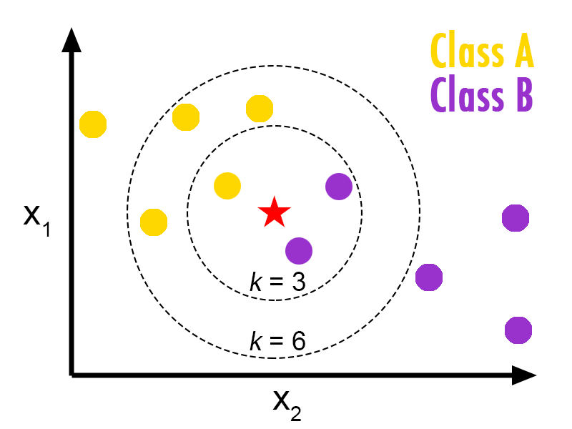
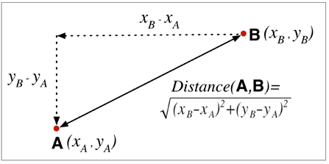
K-Nearest Neighbor (kNN)
Choose the number of K neighbors
Take the nearest K neighbors of the new data point, according to the distance function (usually Euclidean distance)
Among these K neighbors, count the number of data points in each group
Assign the new data point to the group with the most neighbors
Notes:
Non-parametric classification algorithm (a variation of it can also be used for regression)

Slide 36
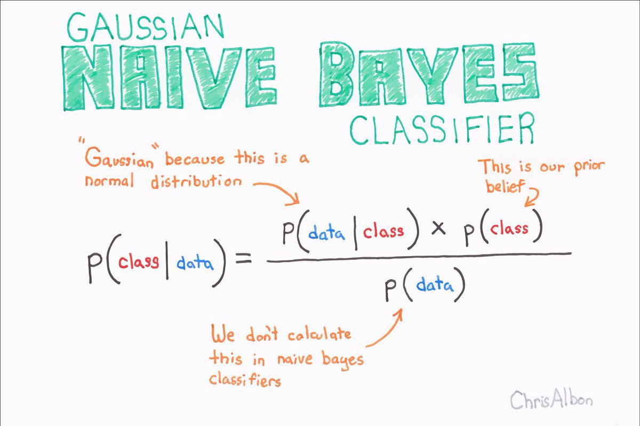
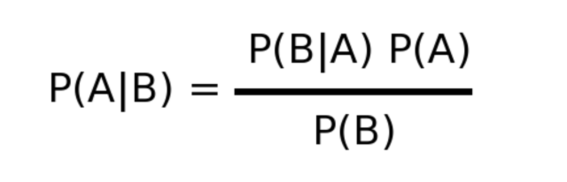
Naïve Bayes
Bayes Theorem:
Probability of A given B =

Slide 37
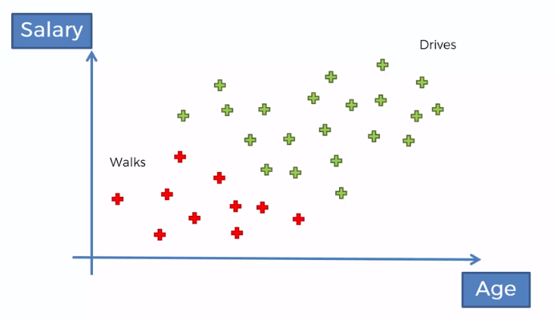
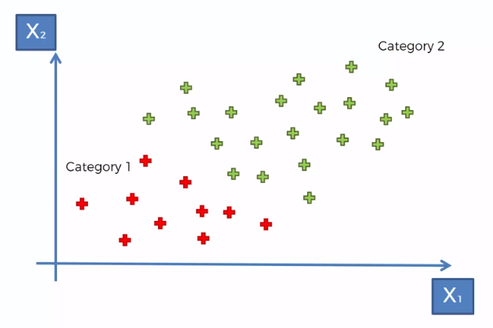
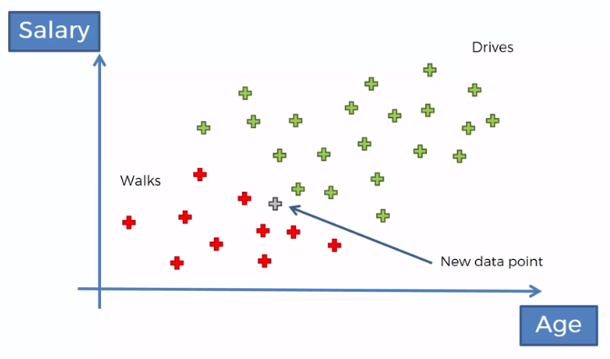
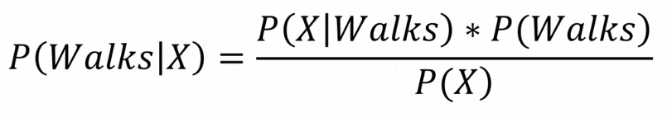
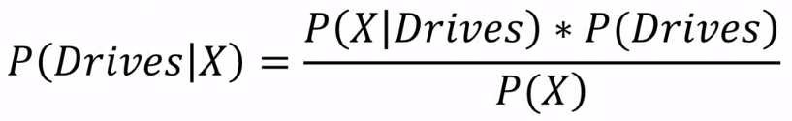

Naïve Bayes example
Notes:
Dataset with 2 features and 2 categories (e.g., Salary and Age features ; walk OR drive categories)
Calculate probability of new data point belonging to each class
Assign new data point to class with higher probability

Slide 38
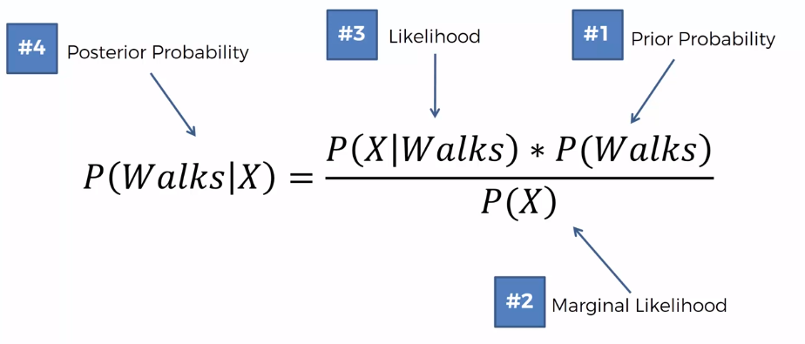
Naïve Bayes example
Notes:
Steps

Slide 39
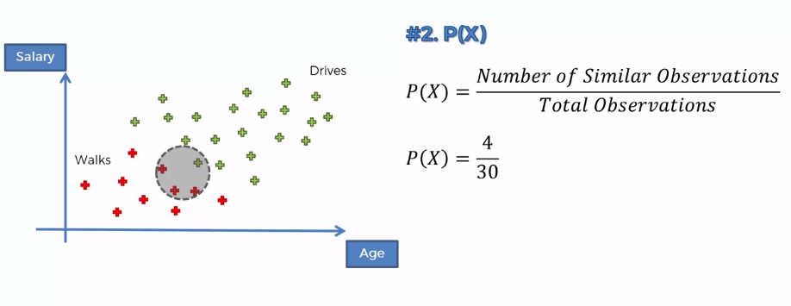
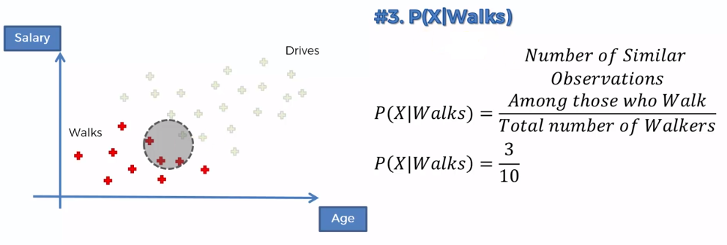
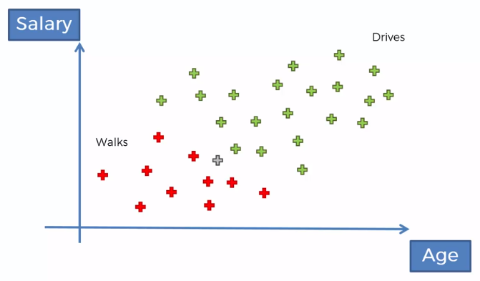
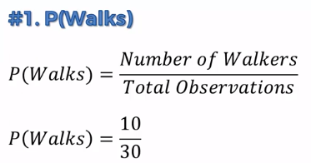
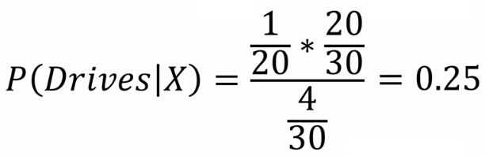
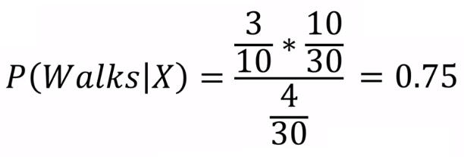
Naïve Bayes example (continued)
Notes:
Probability of walking in our data
Decide a radius (around the new input), this is a model parameter (i.e., hyperparameter)
All points in this circle are assumed similar to a new point
What is the probability of a randomly selected point given that s/he walks (i.e., from the red points), is someone who has features similar to the new point we are adding?
Plug into bayes formula!
Repeat for other class (Drives)
Compare values and assign new data point to class with higher probability

Slide 40
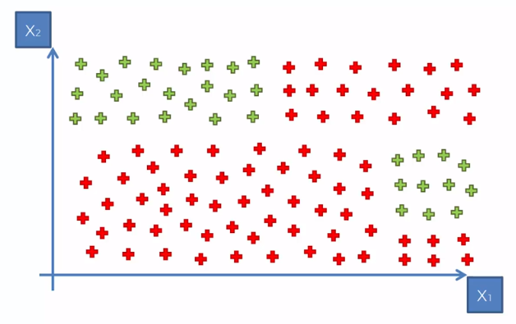
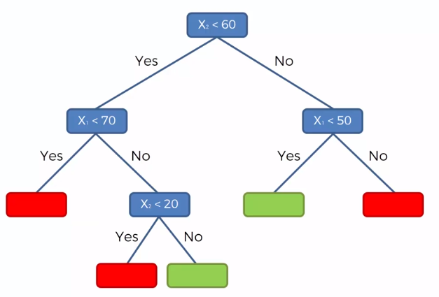
Decision Tree Classification
Split 2
Split 1
Split 3
Split 4
Notes:
Metric for “best” split? Some measure of homogeneity of the target variable within the subsets:
Gini impurity
Information Gain

Slide 41
Random Forest Classification
An ensemble learning method
Uses multiple algorithms (or an algorithm multiple times) to obtain better predictive performance
How does it work?
Pick random K data points from the training set
Build the decision tree for these K data points
Choose the number of trees (N) to build and repeat steps 1 & 2
For a new data point, make each of these N trees predict the category to which the data point belongs and assign the new data point to the category that wins majority vote
Notes:
In RF classification, Out-Of-Bag (OOB) error estimate is the mean prediction error on each training sample Xi, using only the trees that did not have Xi in their bootstrap sample.

Slide 42
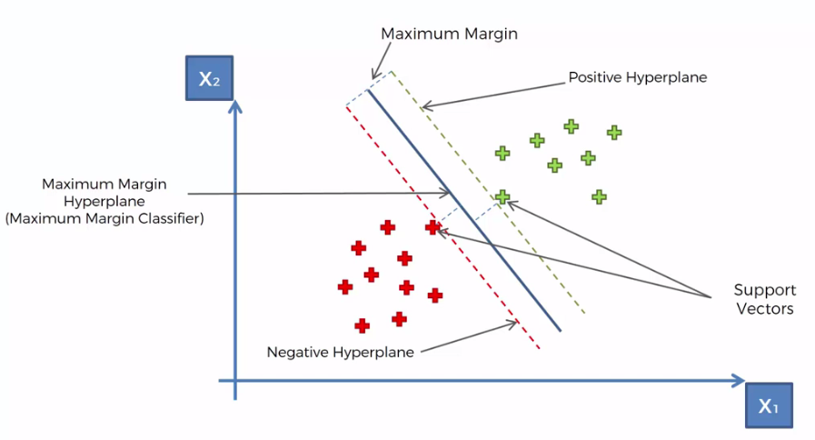
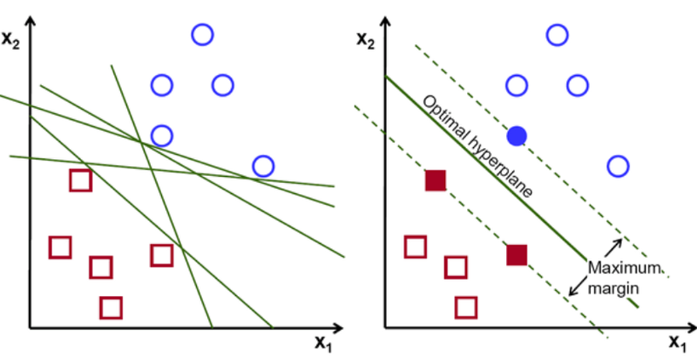
Support Vector Machine (SVM) – intuition
Notes:
SVM tries to fit the largest possible margin between the two classes while limiting margin violations.
Why is SVM powerful?
Considers the extreme observations in each class (i.e., support vectors; observations on the boundaries) to build the classifier.
e.g., cats vs. dogs: cats that are most similar to dogs AND dogs that are on the boundary of being cats are used to determine the boundaries and do the analysis
Hyperplane: is a n-1 dimensional sub-space for any n-dimensional space.

Slide 43
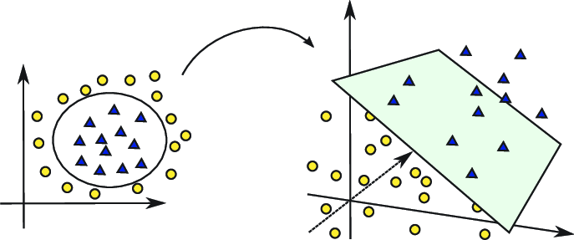
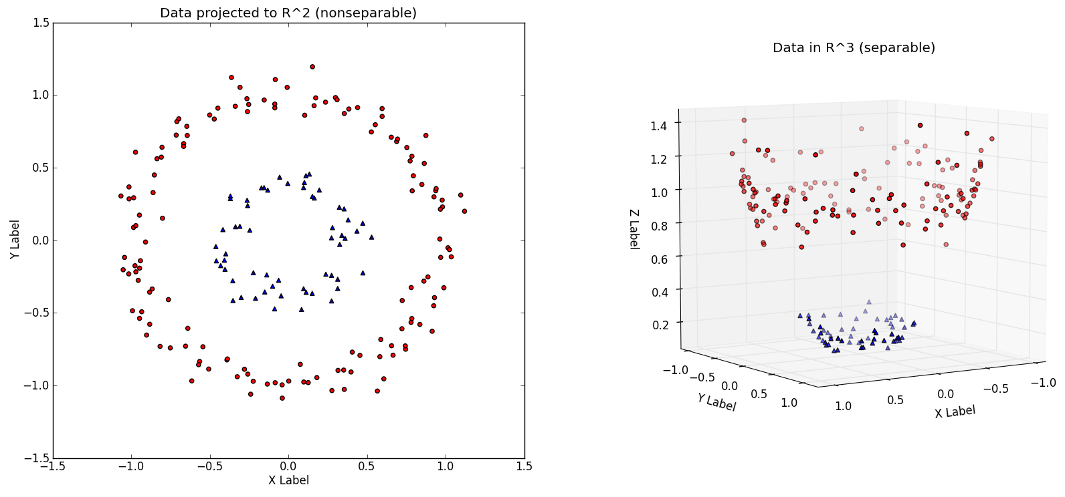
Kernel SVM
Kernel trick: transforming data into another dimension that has a clear dividing margin between classes of data.
Notes:
Data is not linearly separable…
Kernel functions allow us to do that! => try to find a non-linear decision boundary

Slide 44
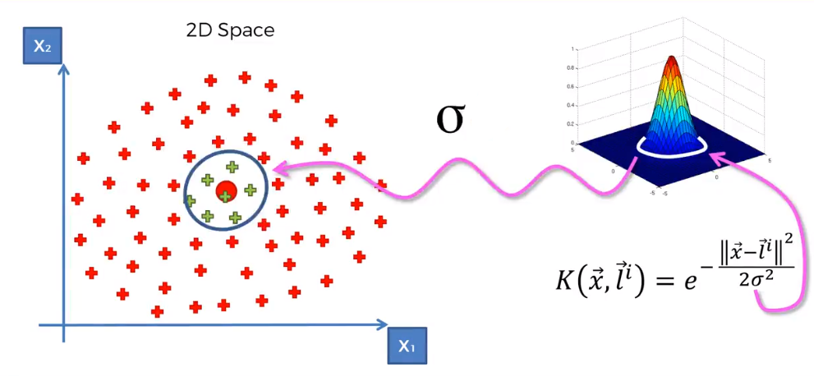
Gaussian RBF Kernel

Slide 45
Classification – model comparison
Model | Pros | Cons
Logistic Regression | Probabilistic approach, gives information about statistical significance of features | The Logistic Regression Assumptions
K-NN | Simple to understand, fast and efficient | Need to choose the number of neighbors k
SVM | Performant, not biased by outliers, not sensitive to overfitting | Not appropriate for non linear problems, not the best choice for large number of features
Kernel SVM | High performance on nonlinear problems, not biased by outliers, not sensitive to overfitting | Not the best choice for large number of features, more complex
Naive Bayes | Efficient, not biased by outliers, works on nonlinear problems, probabilistic approach | Based on the assumption that features have same statistical relevance
Decision Tree Classification | Interpretability, no need for feature scaling, works on both linear / nonlinear problems | Poor results on small datasets, overfitting can easily occur
Random Forest Classification | Powerful and accurate, good performance on many problems including non-linear | No interpretability, overfitting can easily occur, need to choose the number of trees

Slide 46
Summary
Supervised Learning
Numeric Prediction
Linear Regression
Support Vector Regression
Classification
Logistic Regression
Time series
Decision Tree Regression
Random Forest Regression
K nearest neighbor (k-NN)
Support Vector Machine (SVM)
Naïve Bayes
Decision Tree Classification
Random Forest Classification
To be discussed

